Slide 1

Credit CARD FRAUD DETECTION.
AIDI 1006 Assignment 4
Members
Akshaykumar Thakare
(200523970)
Manav Kumbhani
(200509153)
9.24.XX

Slide 2
In THIS PRESENTATION
Selected Solution: Credit Card Fraud Detection
Solution is based on Microsoft Azure
Data Source: CreditCard.csv
Programming Language: Python
Visualization Tool: PowerPoint

Slide 3

OVERVIEW

Slide 4
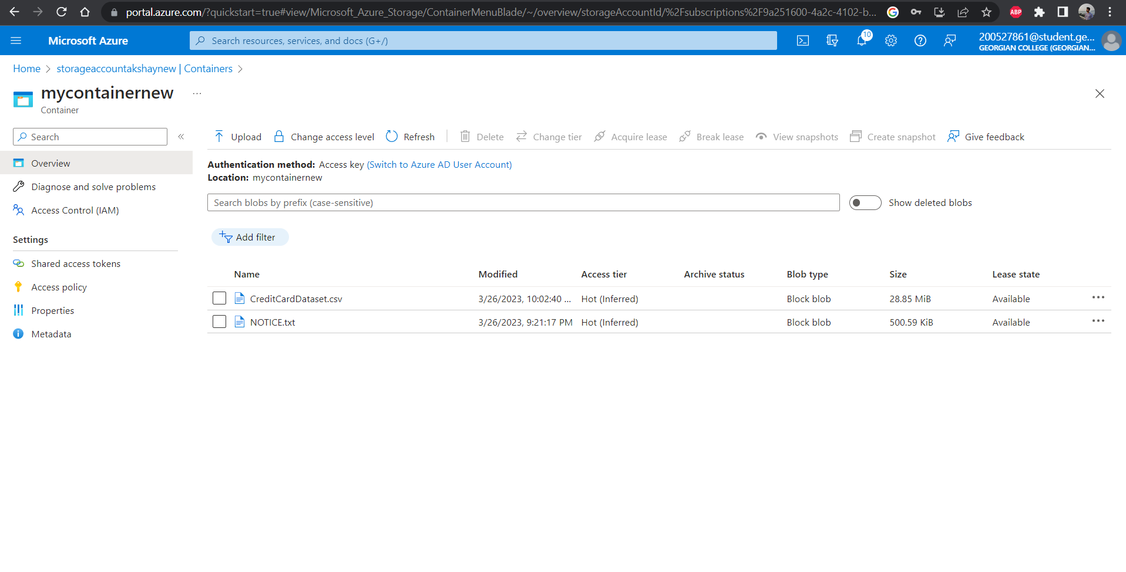
Data Loading

Slide 5
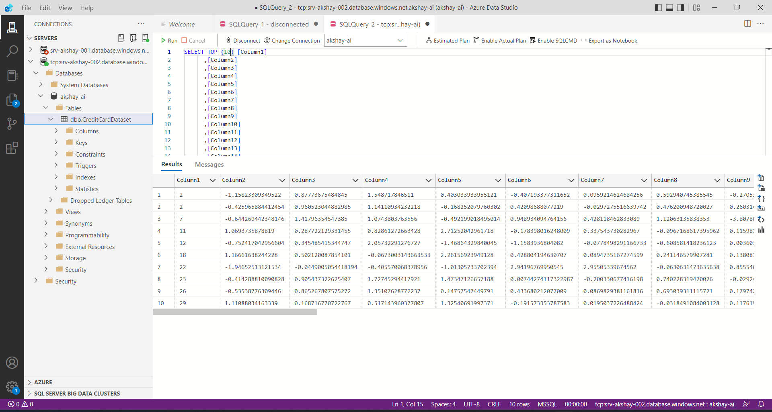
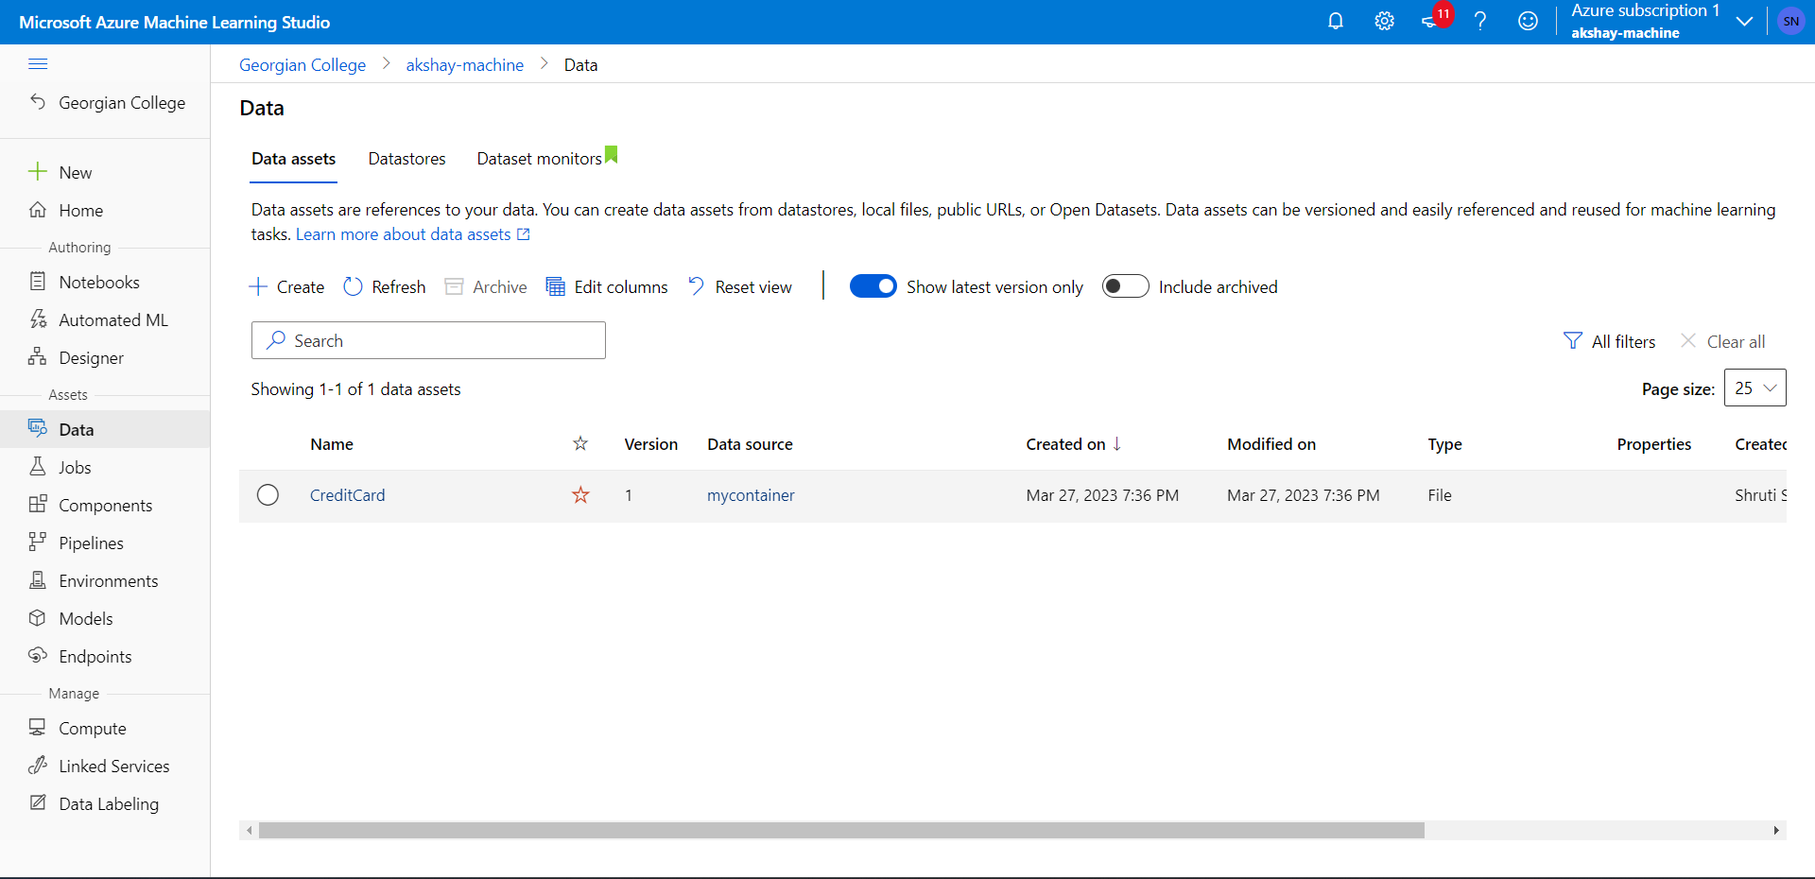
Data Loading

Slide 6
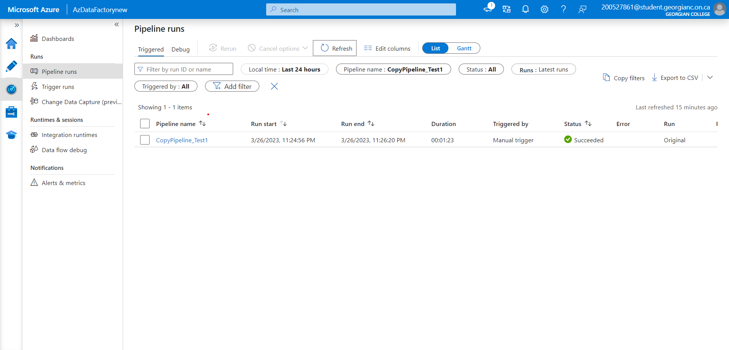
Data Loading

Slide 7
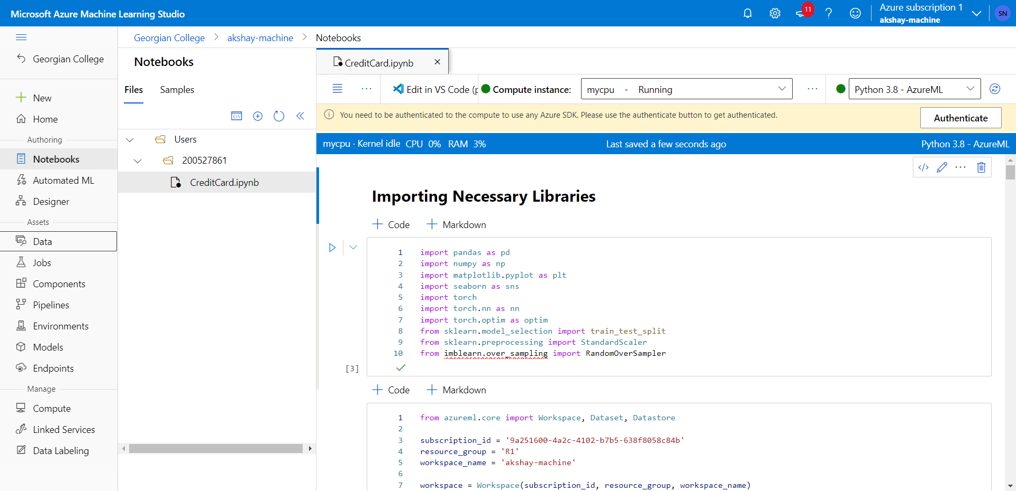
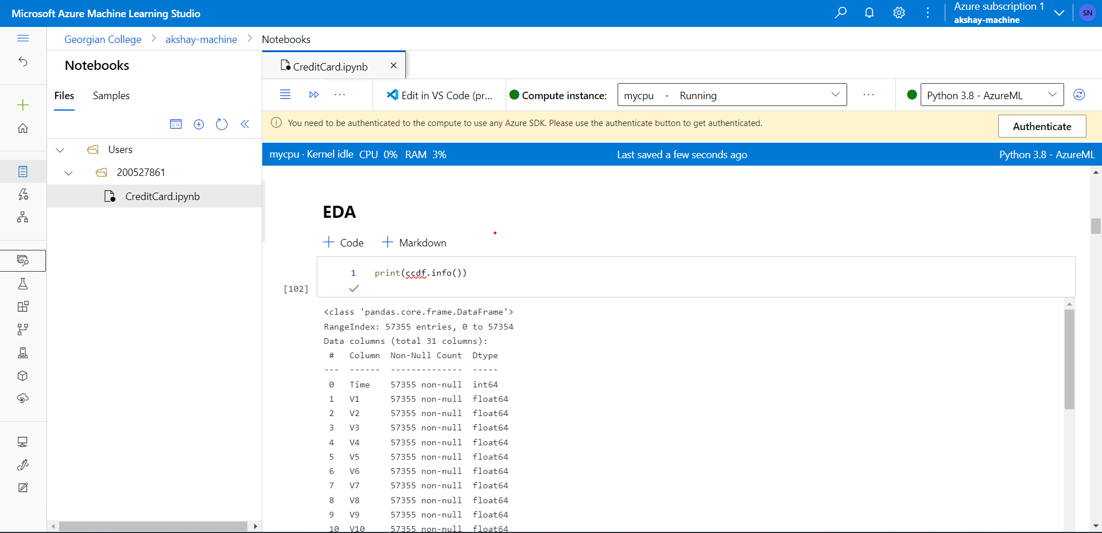
Machine Learning Code

Slide 8
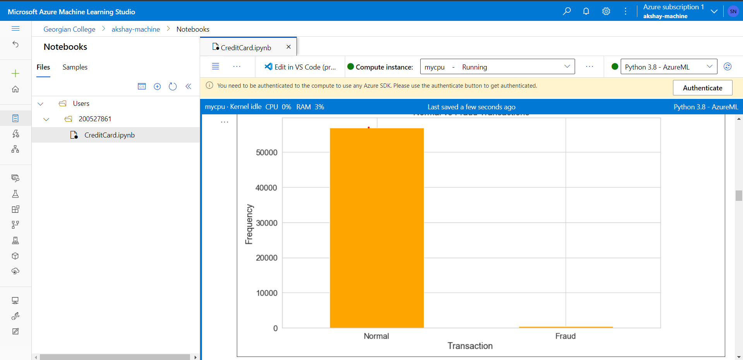
Machine Learning Code

Slide 9
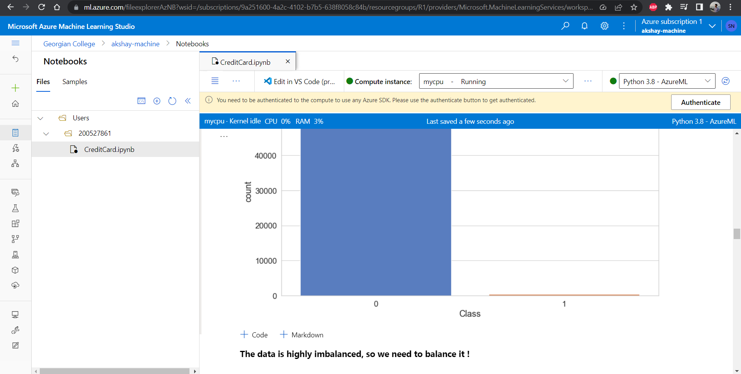
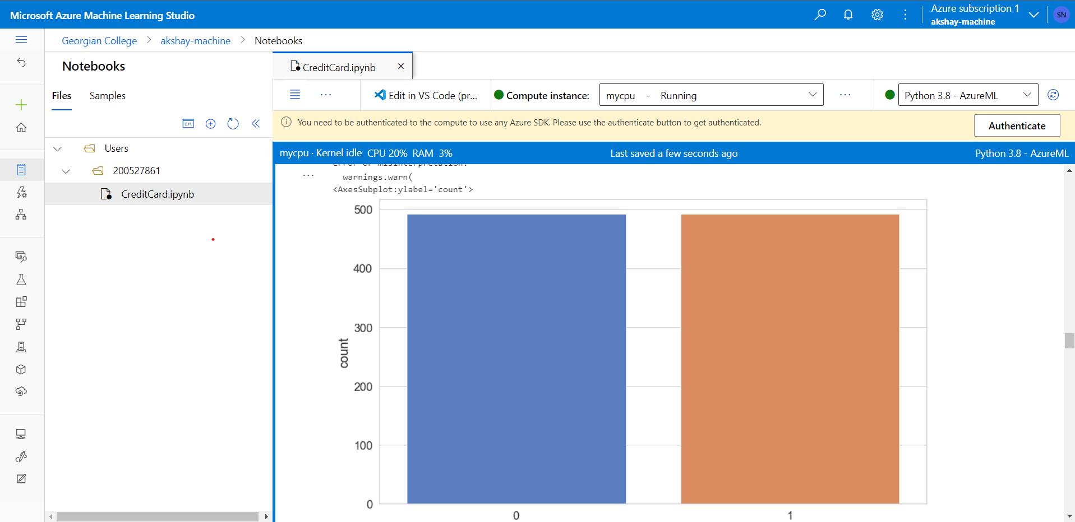
Machine Learning Code

Slide 10
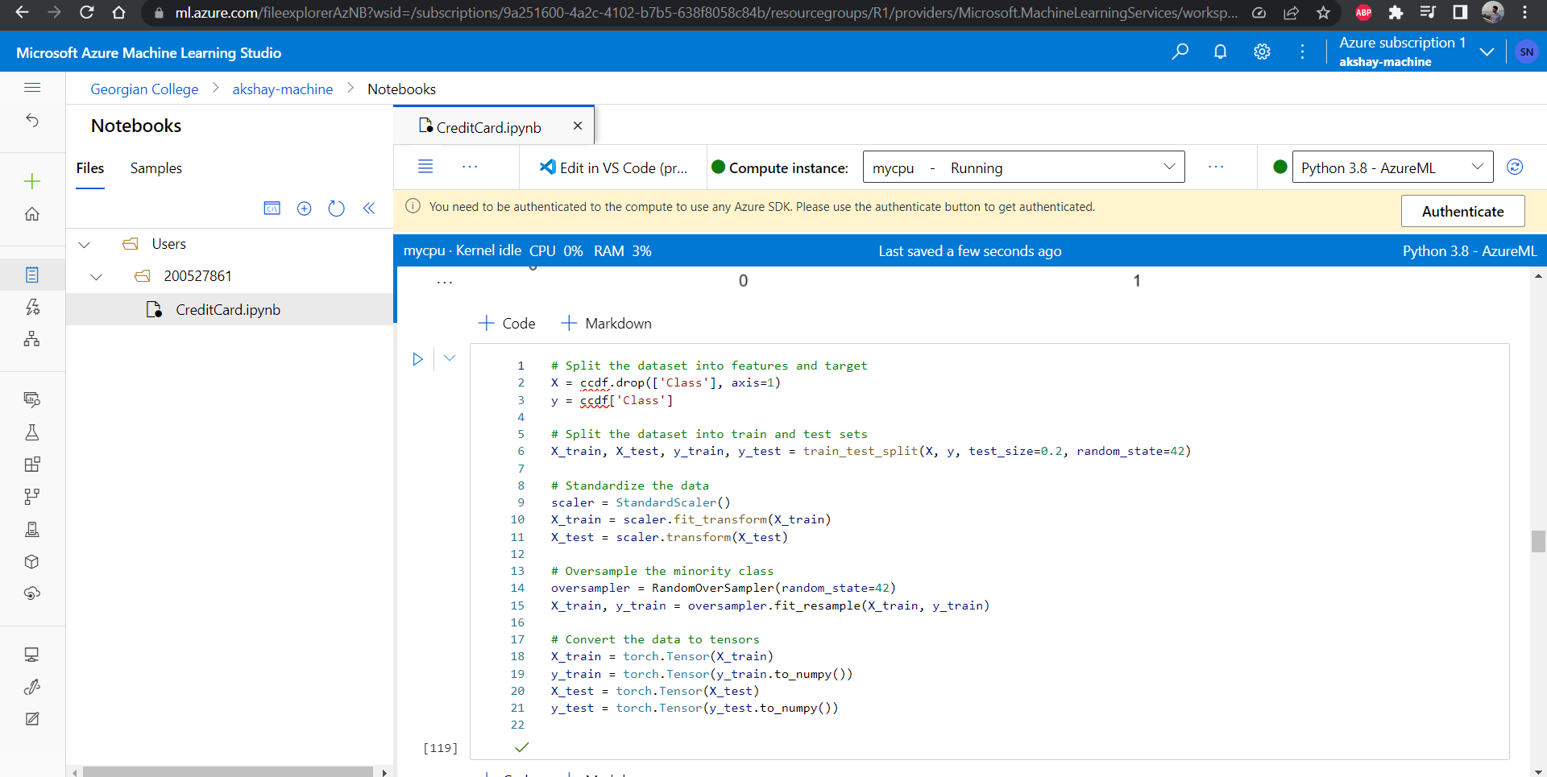
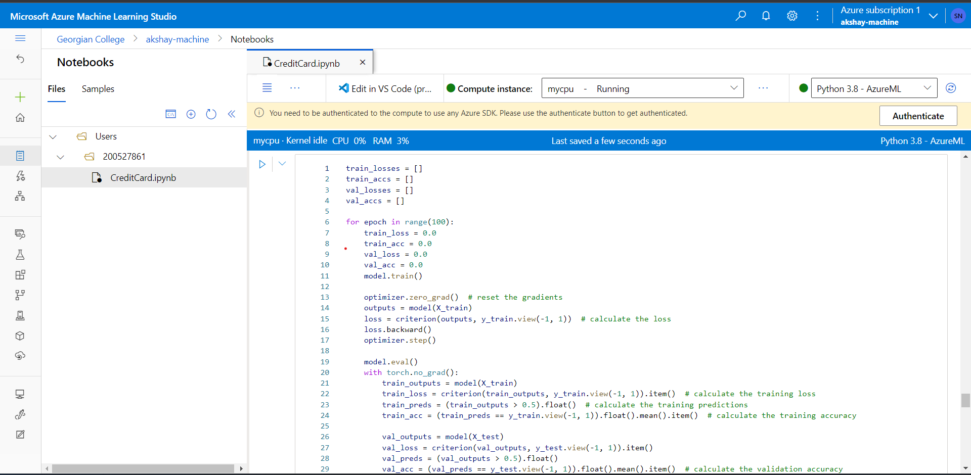
ML Modelling

Slide 11
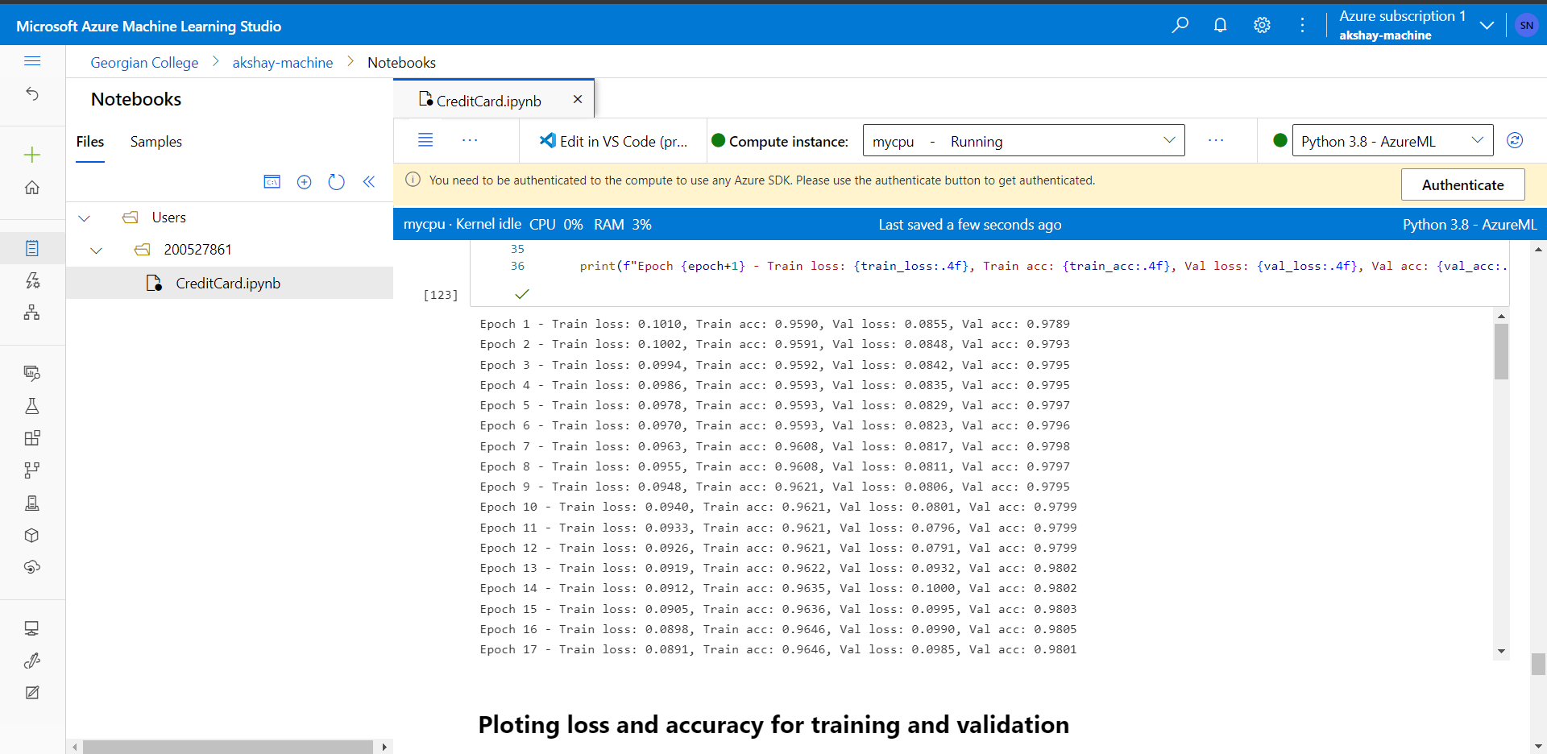
ML Modelling (Accuracy 98%)

Slide 12
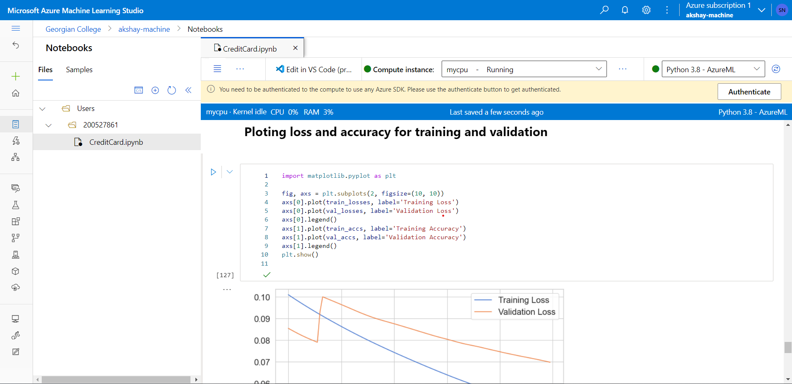
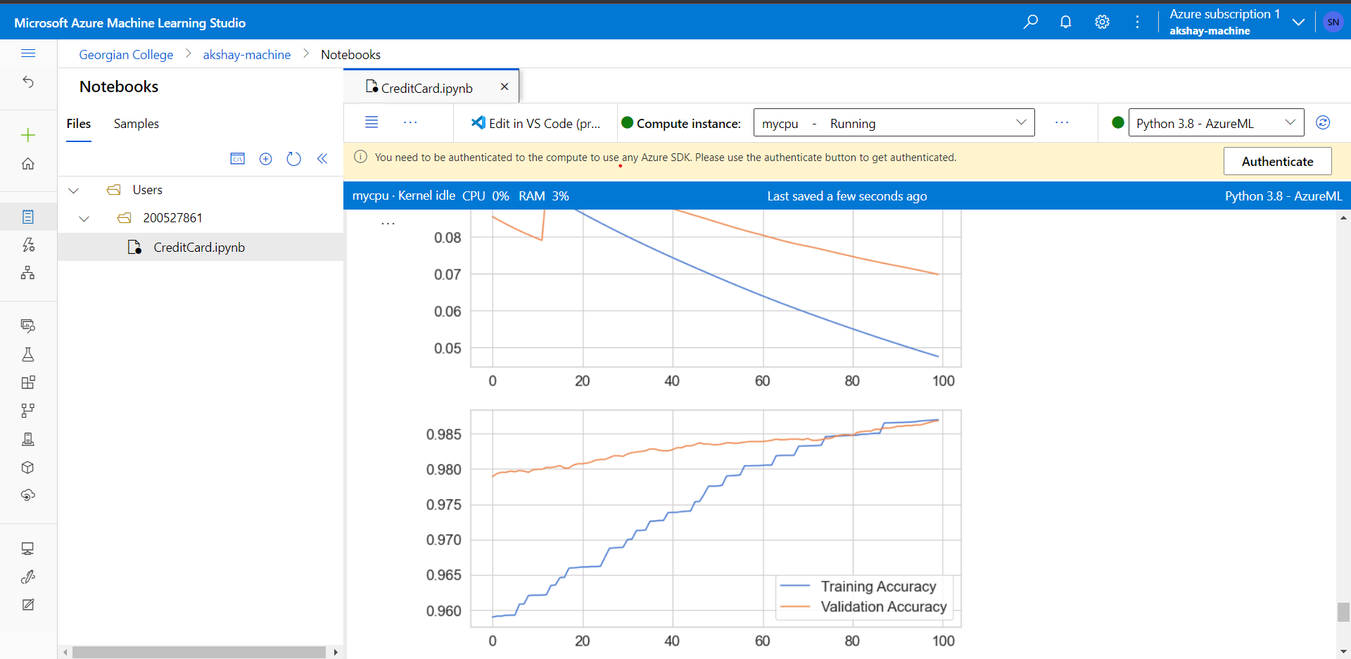
ML Modelling (Visualizing)

Slide 13
THANK YOU

